Slide 1



TOPOLOGY
컴퓨터 네트워크
RIP & EIGRP & OSPF
망 구성 및 실습
RIP
EIGRP
OSPF
VLAN
201495013 김재영
201495024 문아성
REDISTRIBUTE

Slide 2
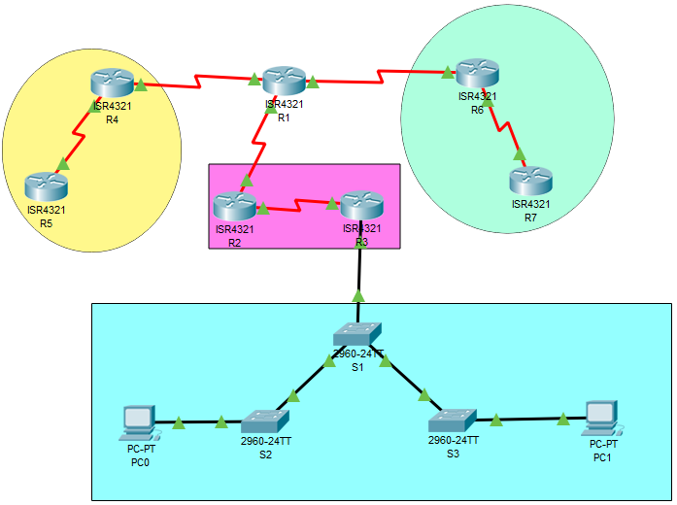
Topology
40.40.41.0
40.40.42.0
EIGRP
20.20.20.0
30.30.30.0
40.40.40.0
RIP
OSPF
10.10.10.0
172.17.99.0
VLAN
172.17.99.11
172.17.99.13
172.17.99.12

Slide 3
Address-Table
Device | Interface | IP Address | Subnet Mask | Default Gateway
R1 | Gig 1/0/1 | 40.40.40.2 | 255.255.255.252 | N/A
 | Gig 1/0/2 | 40.40.41.1 | 255.255.255.252 | N/A
 | Gig 1/0/3 | 40.40.42.1 | 255.255.255.252 | N/A
R2 | Gig 0/8 | 40.40.40.1 | 255.255.255.252 | N/A
 | Gig 0/9 | 10.10.10.1 | 255.255.255.252 | N/A
R3 | Gig 0/8 | 10.10.10.2 | 255.255.255.252 | N/A
R4 | Gig 0/8 | 20.20.20.1 | 255.255.255.252 | N/A
 | Gig 0/9 | 40.40.41.2 | 255.255.255.252 | N/A
R5 | Gig 0/8 | 20.20.20.2 | 255.255.255.252 | N/A
Device | Interface | IP Address | Subnet Mask | Default Gateway
R6 | Gig 0/8 | 40.40.42.2 | 255.255.255.252 | N/A
 | Gig 0/9 | 30.30.30.1 | 255.255.255.252 | N/A
R7 | Gig 0/9 | 30.30.30.2 | 255.255.255.252 | N/A
S1 | VLAN 99 | 172.17.99.11 | 255.255.255.252 | N/A
S2 | VLAN 99 | 172.17.99.12 | 255.255.255.252 | N/A
S3 | VLAN 99 | 172.17.99.13 | 255.255.255.252 | N/A
PC 1 | VLAN 10 | 172.17.10.21 | 255.255.255.252 | N/A
PC 2 | VLAN 10 | 172.17.10.24 | 255.255.255.252 | N/A

Slide 4
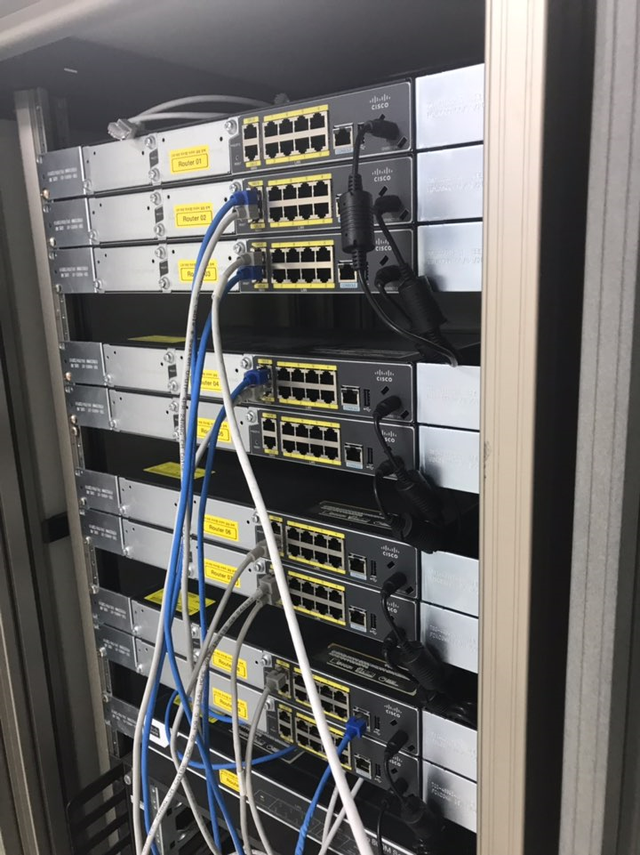
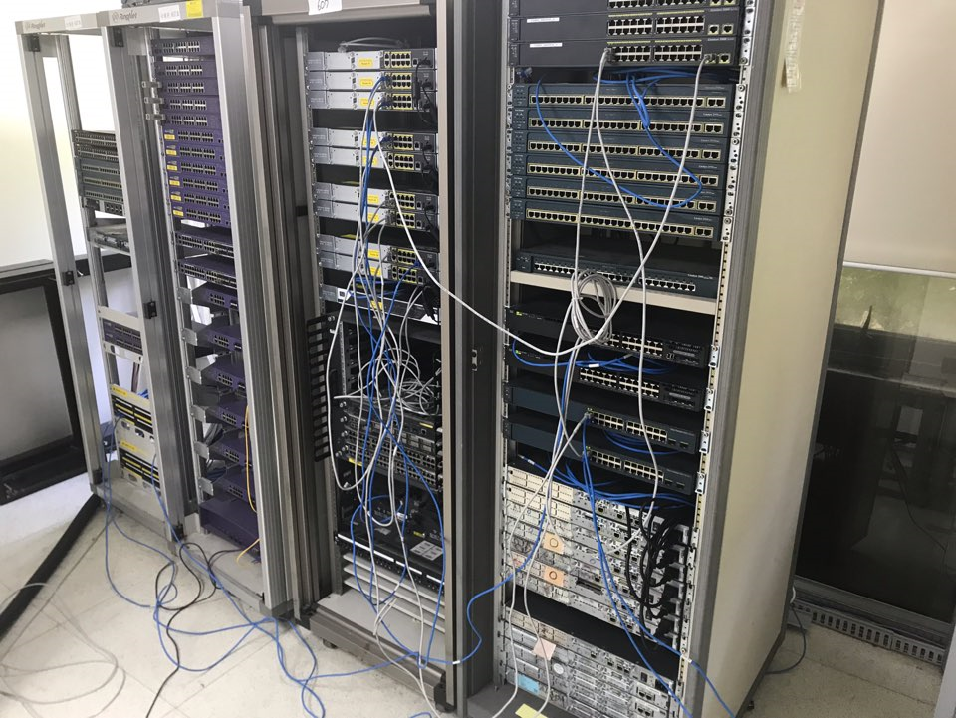
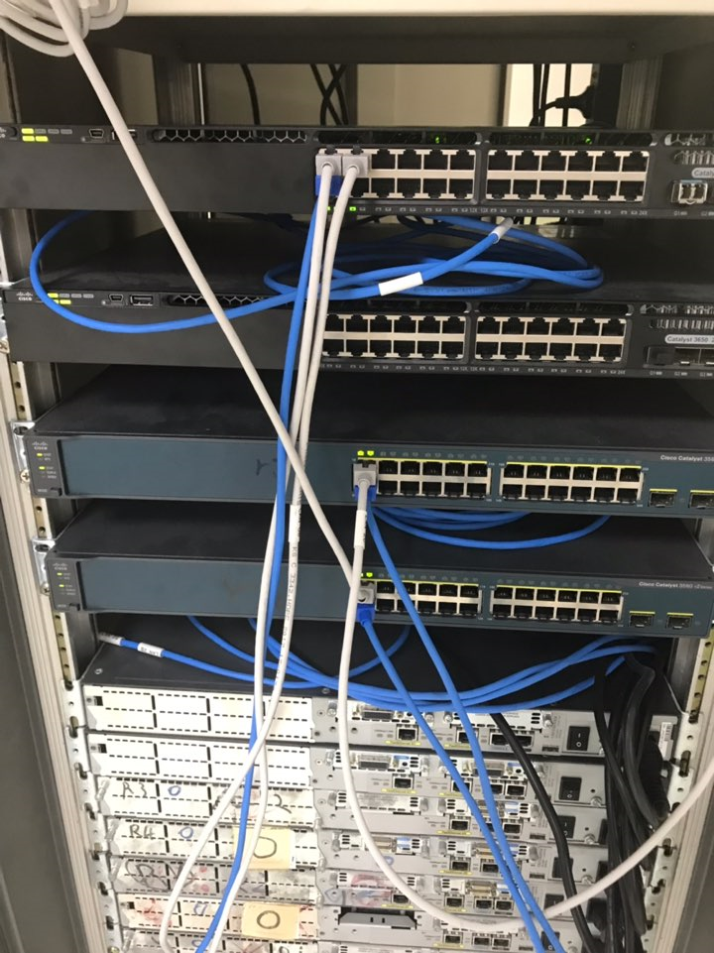
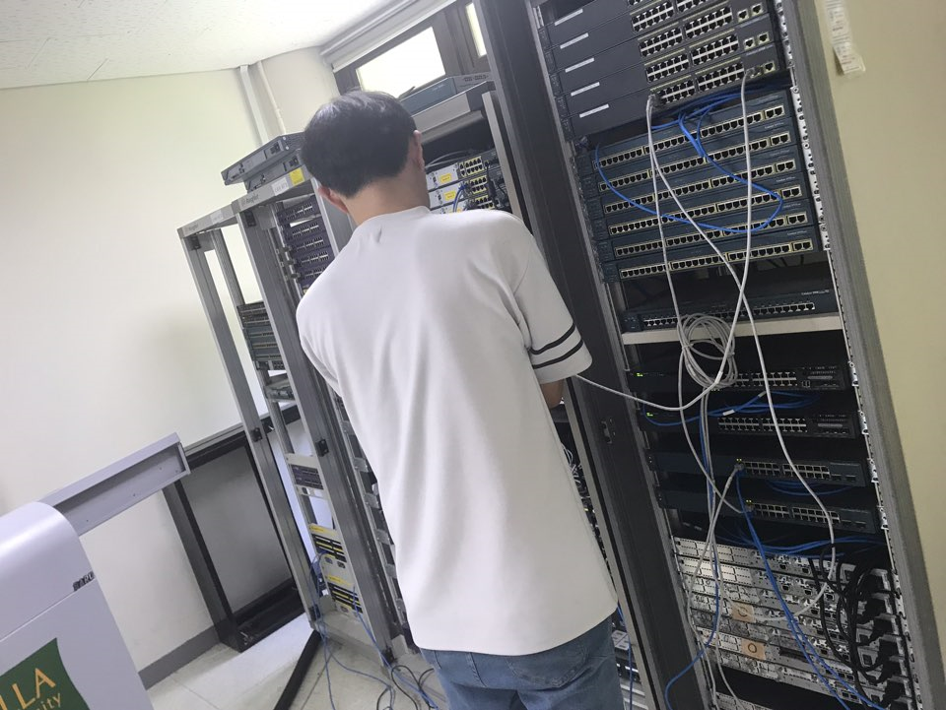
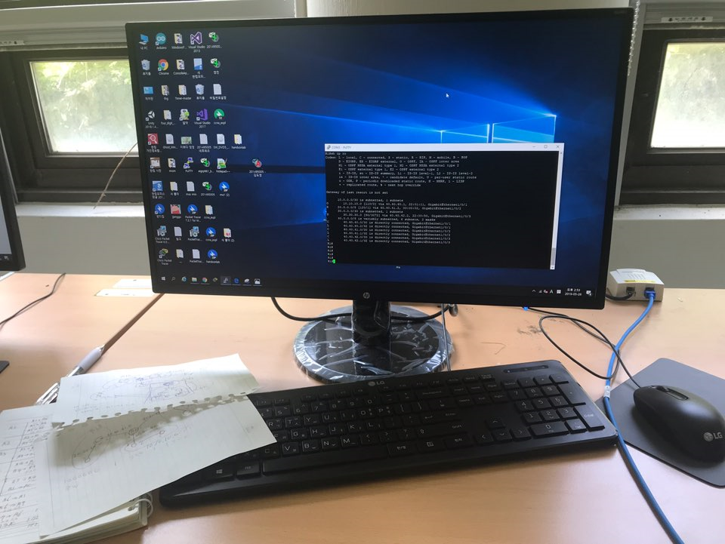
PHOTO
PC

Slide 5
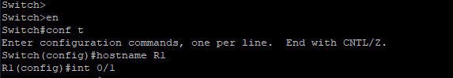
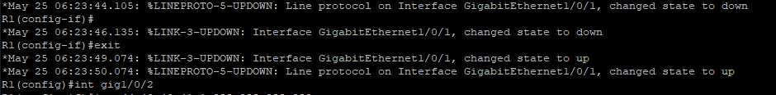
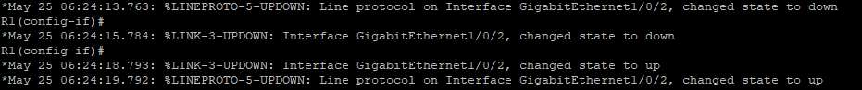
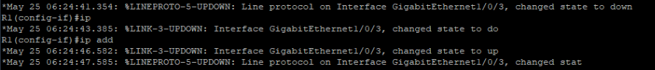
IP CONFIGURATION
40.40.41.0
40.40.42.0
20.20.20.0
40.40.40.0
30.30.30.0
10.10.10.0
172.17.99.0
172.17.99.11
172.17.99.12
172.17.99.13

Slide 6
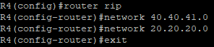
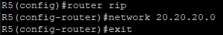
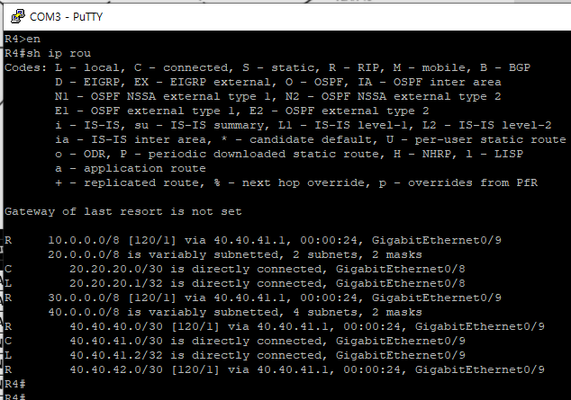
RIP - Routing-Command
40.40.41.0
40.40.42.0
20.20.20.0
40.40.40.0
30.30.30.0
10.10.10.0
RIP - Routing-Table
172.17.99.0
172.17.99.11
172.17.99.12
172.17.99.13

Slide 7
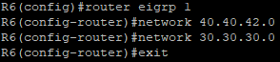
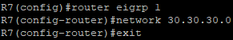
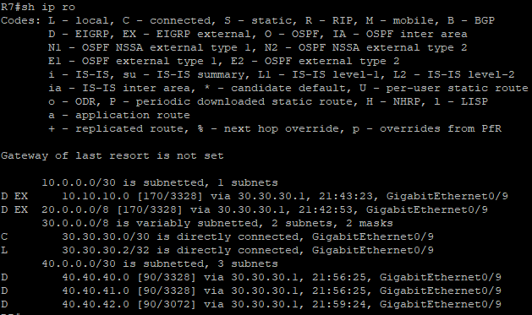
EIGRP - Routing-Command
40.40.41.0
40.40.42.0
20.20.20.0
40.40.40.0
30.30.30.0
10.10.10.0
EIGRP - Routing-Table
172.17.99.0
172.17.99.11
172.17.99.12
172.17.99.13

Slide 8
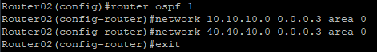
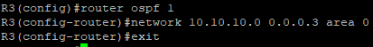
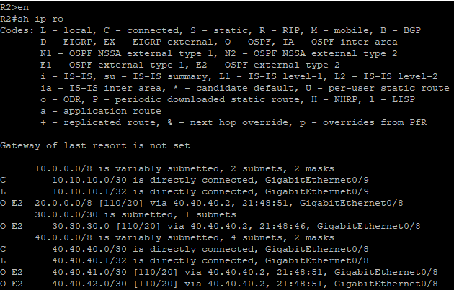
OSPF - Routing-Command
40.40.41.0
40.40.42.0
20.20.20.0
40.40.40.0
30.30.30.0
10.10.10.0
OSPF - Routing-Table
172.17.99.0
172.17.99.11
172.17.99.12
172.17.99.13

Slide 9
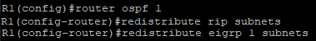
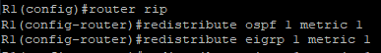
REDISTRIBUTE
40.40.41.0
40.40.42.0
– OSPF
20.20.20.0
40.40.40.0
30.30.30.0
10.10.10.0
– RIP
172.17.99.0
초기 매트릭을 1로 설정하여 재분배
172.17.99.11
172.17.99.12
172.17.99.13

Slide 10
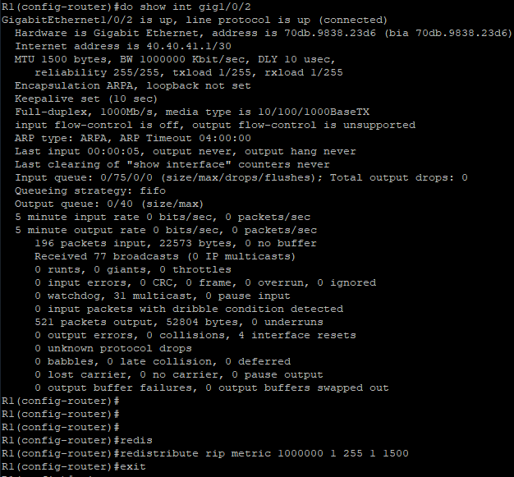
REDISTRIBUTE - EIGRP
EIGRP 초기 매트릭 설정
Bandwidth(Kbit)
Delay(10 microsecond)
Reliability
Load
MTU 값 입력
적는 순서 : BW > DLY > Reli > Load > MTU
40.40.41.0
40.40.42.0
MTU
BW
DLY
Reli
Load
20.20.20.0
40.40.40.0
30.30.30.0
10.10.10.0
172.17.99.0
EIGRP 초기 매트릭 설정
Bandwidth(Kbit)
Delay(10 microsecond)
Reliability
Load
MTU 값 입력
적는 순서 : BW > DLY > Reli > Load > MTU
172.17.99.11
172.17.99.12
172.17.99.13

Slide 11
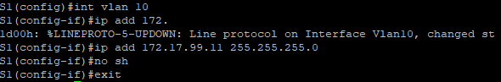
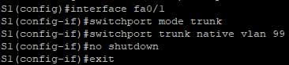
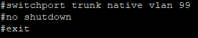
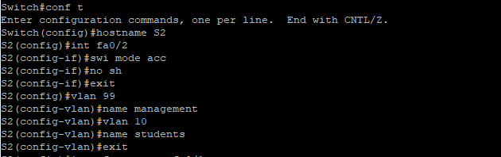
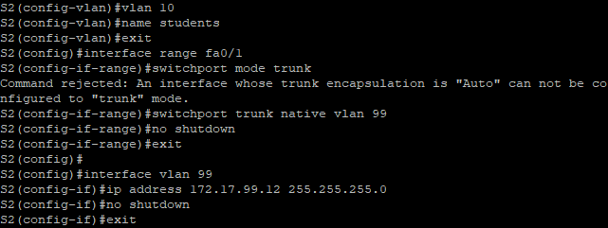
VLAN - IP CONFIGURATION
40.40.41.0
40.40.42.0
20.20.20.0
40.40.40.0
30.30.30.0
10.10.10.0
172.17.99.0
172.17.99.11
172.17.99.12
172.17.99.13

Slide 12
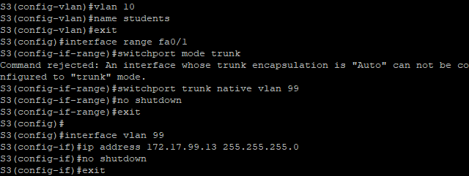
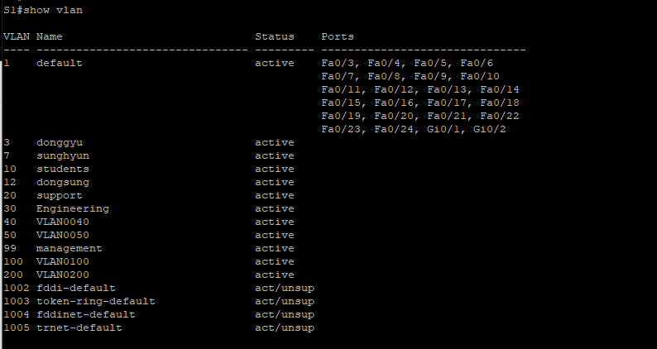
40.40.41.0
40.40.42.0
20.20.20.0
40.40.40.0
30.30.30.0
10.10.10.0
172.17.99.0
172.17.99.11
172.17.99.12
172.17.99.13

Slide 13
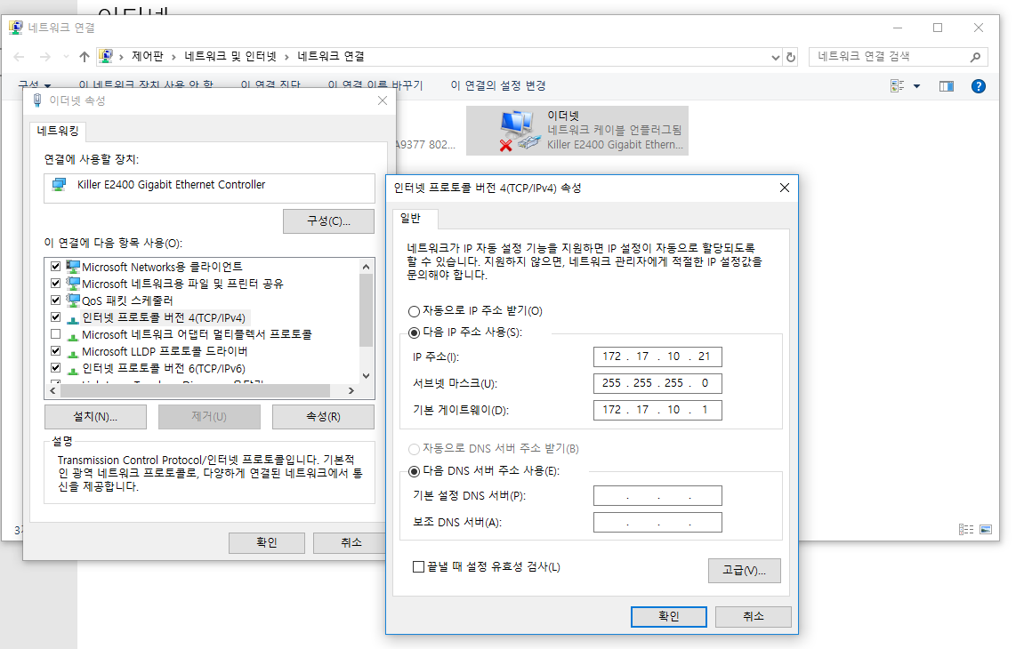
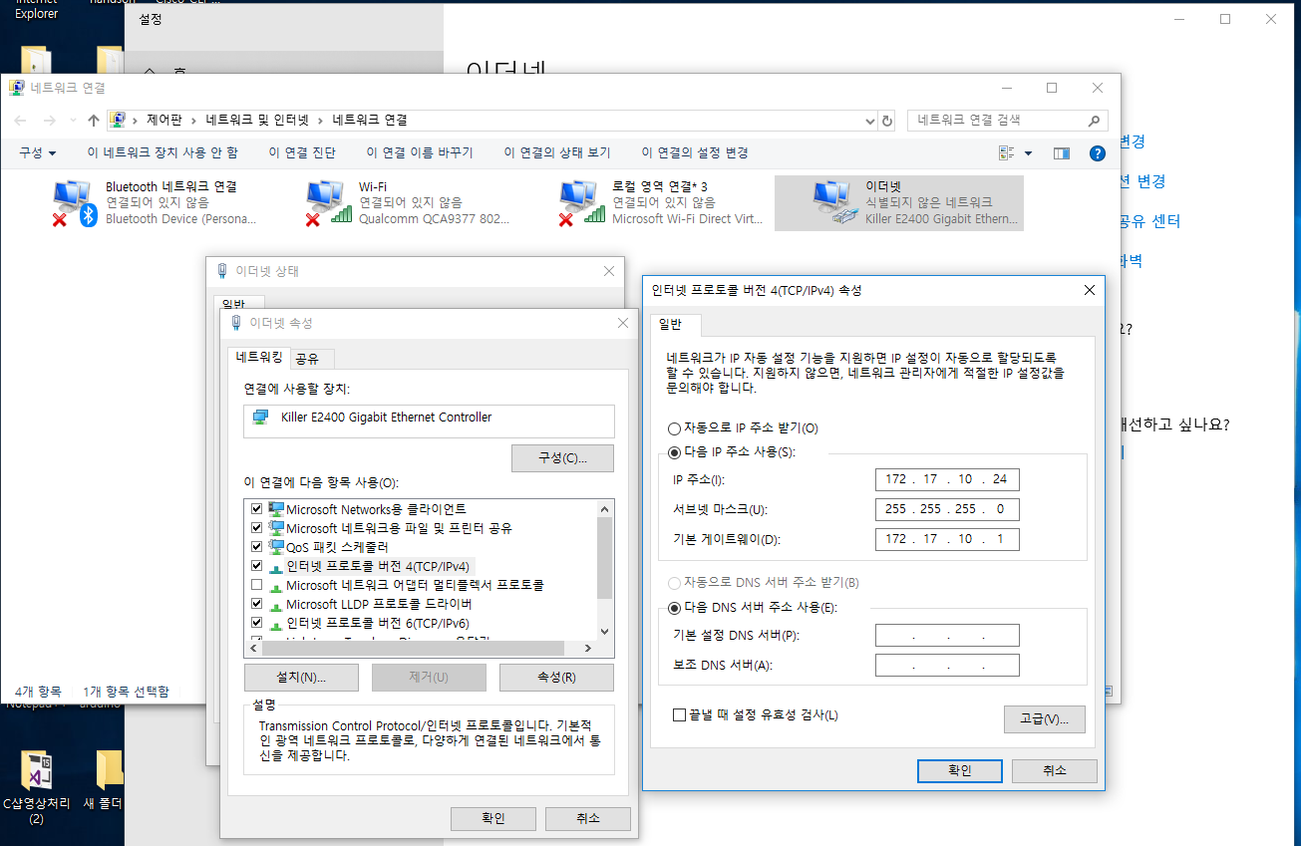
PC1, PC2 IP CONFIGURATION

Slide 14
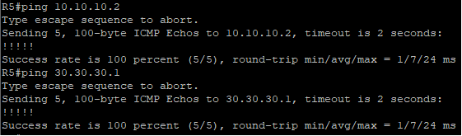
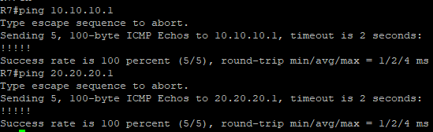
Ping-Test R5 to R3, R7
40.40.41.0
40.40.42.0
`
`
20.20.20.0
40.40.40.0
30.30.30.0
10.10.10.0
Ping-Test R3 to R5, R7
172.17.99.0
172.17.99.11
172.17.99.12
172.17.99.13

Slide 15
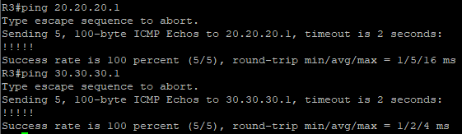
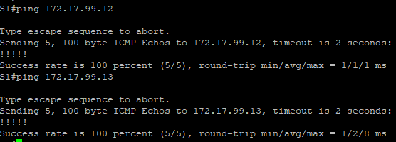
Ping-Test R7 to R3, R5
`
40.40.41.0
40.40.42.0
20.20.20.0
40.40.40.0
30.30.30.0
10.10.10.0
Ping-Test VLAN
172.17.99.0
172.17.99.11
172.17.99.12
172.17.99.13

Slide 16
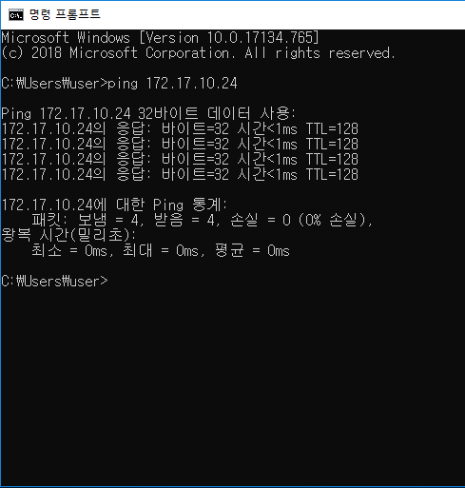
Ping-Test PC1 to PC2
40.40.41.0
40.40.42.0
20.20.20.0
40.40.40.0
30.30.30.0
10.10.10.0
172.17.99.0
172.17.99.11
172.17.99.12
172.17.99.13

Slide 17
END

